Slide 1

Fusion 360
Basics of CAD

Slide 2

What is CAD and Why do we use it?
CAD (Computer Aided Design) is the computer software tool which allows us to create 2D and 3D designs
Makes our lives a lot easier
  Visualization
  Prototyping
  FEA (stress testing, shape optimization)
  Drawings
  Manufacturing (Laser cutting, CNC, 3D printing)
Focusing on Fusion
  Free for Purdue Students
  Many other softwares (Solidworks, NX, Onshape, AutoCAD)

Slide 3
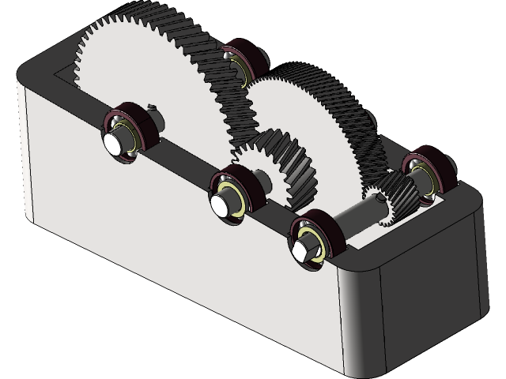
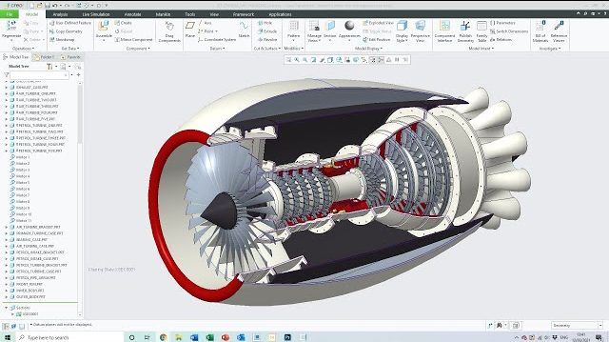
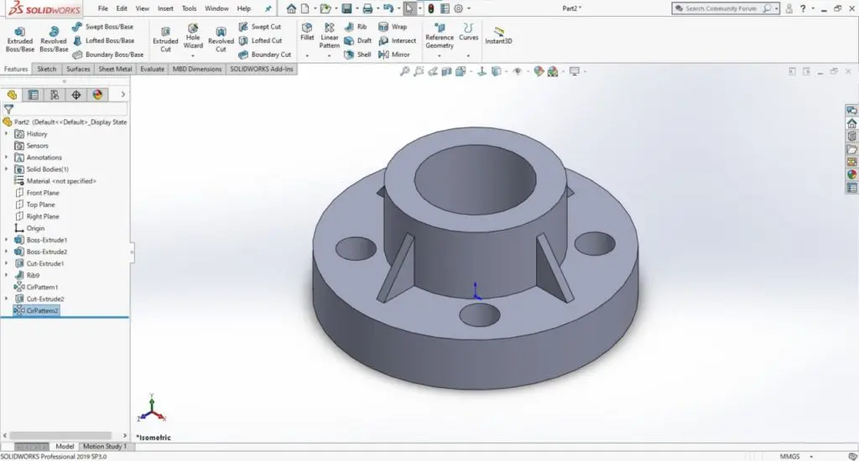
Examples
Flange
Gear Box
Jet Engine

Slide 4
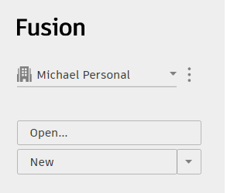
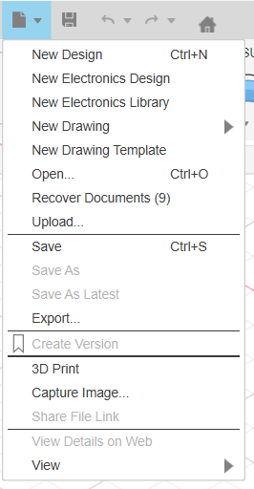
Creating Files

Slide 5
Sketches

Slide 6

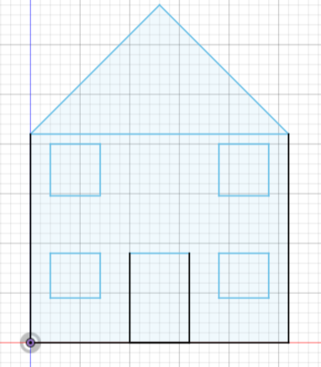
Basics
Sketches help lay the foundation for your model
2D profile on a specified plane, made with lines, arcs, circles, rectangles…
Fully defined/constrained = all geometry has its size, position in the plane, and relationships fixed

Slide 7
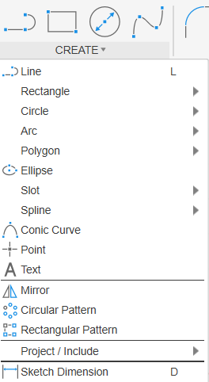
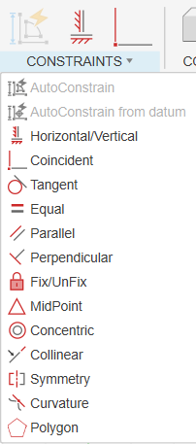

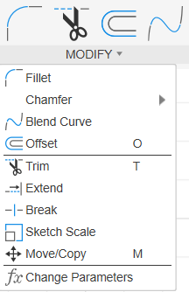

Sketching Tools

Slide 8
Practice
Sketch a 10x15 rectangle (mm or inches)
Sketch a circle with radius of 25
Sketch a simple house outline

Slide 9
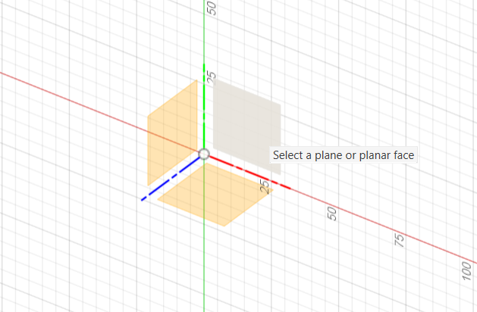
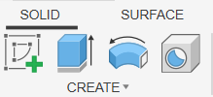
Solution
Rectangle

Slide 10
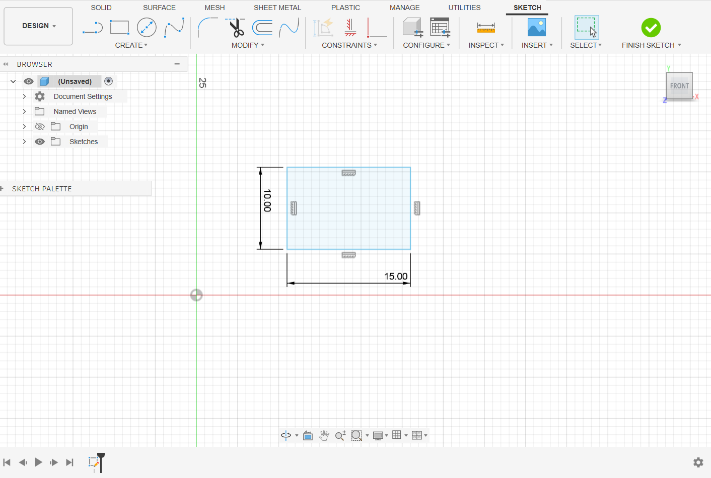
Solution
Rectangle

Slide 11
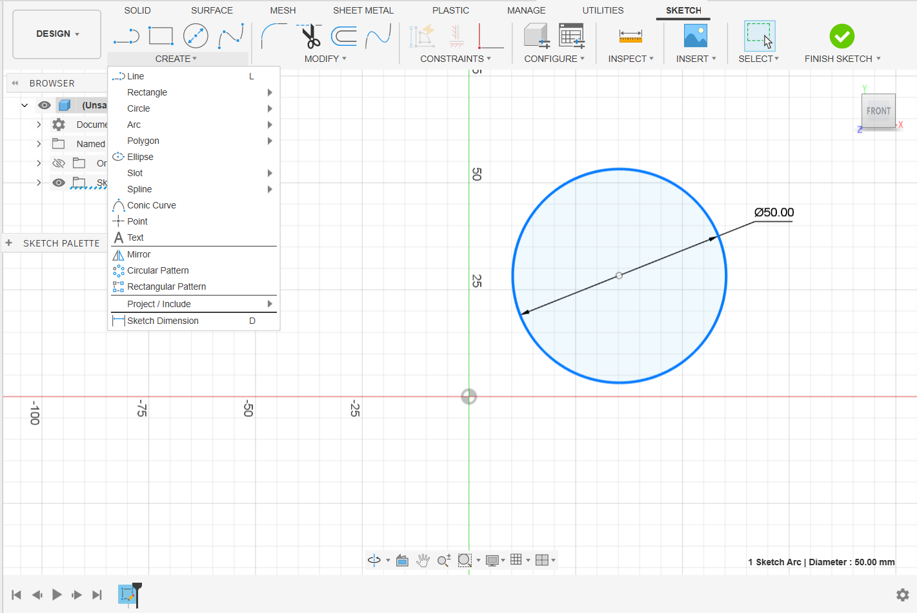
Solution
2) Circle

Slide 12
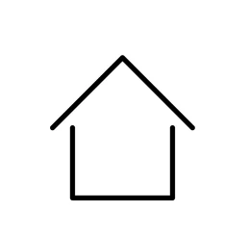
Solution
3) House

Slide 13
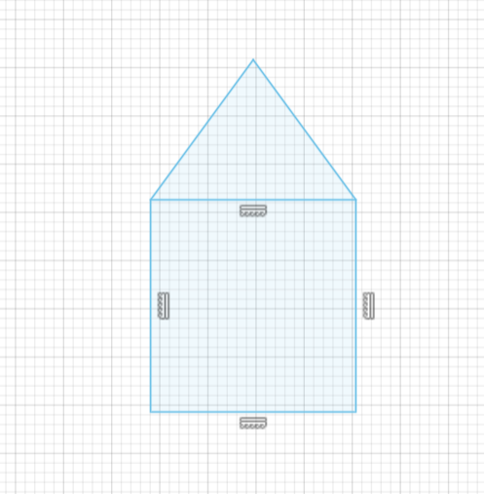
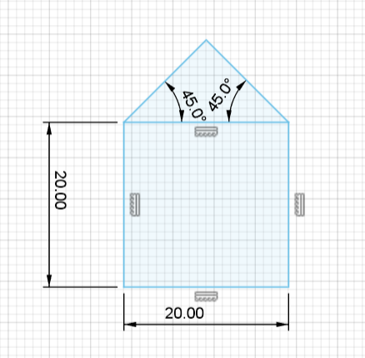
Solution

Slide 14
Practice
Sketch a 10x15 rectangle (mm or inches) with a corner on the origin
Sketch a circle with radius of 25 centered around the origin
Sketch a fully constraint house with a rounded roof

Slide 15
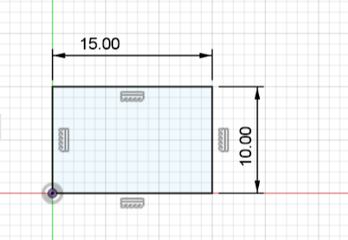
Solutions
Rectangle

Slide 16
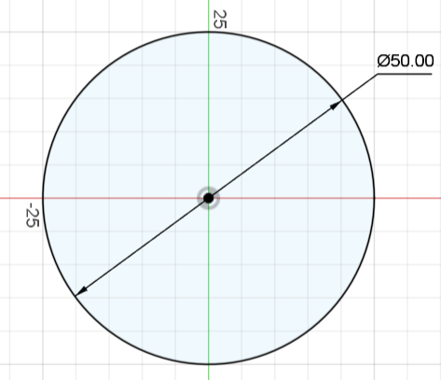
Solutions
2) Circle

Slide 17
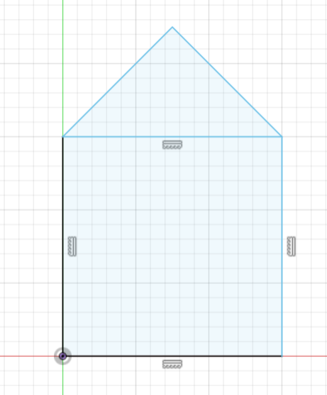
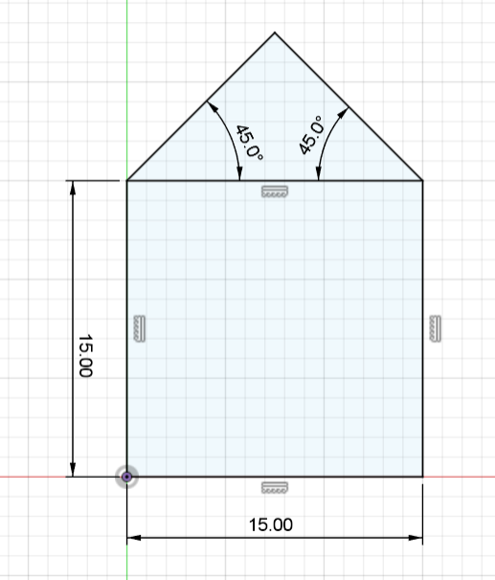
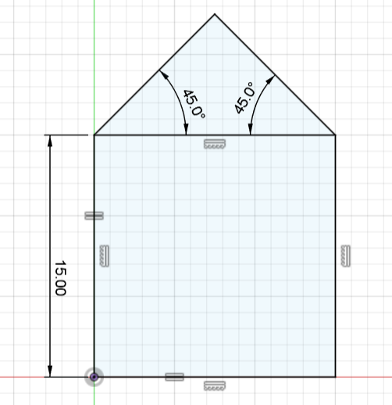
Solution
3) House

Slide 18
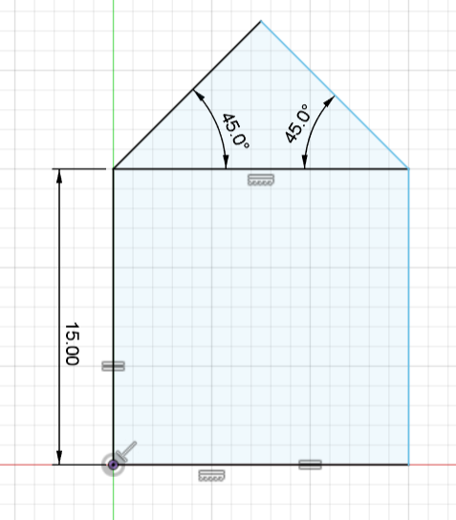
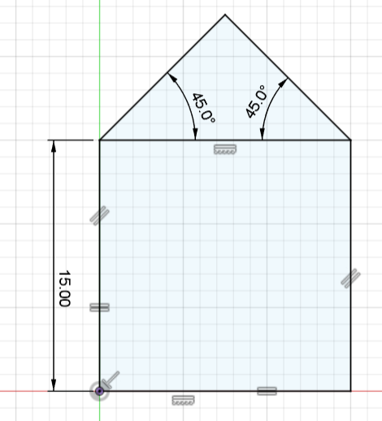
Solution
3) House

Slide 19

Steps for a good sketch
Define your plane
Create your desired shape
Add constraints and dimensions

Slide 20

DEMO!
Goal
Create a simple sketch of your own Purdue P
Define your plane
Create your desired shape
Add constraints and dimensions

Slide 21
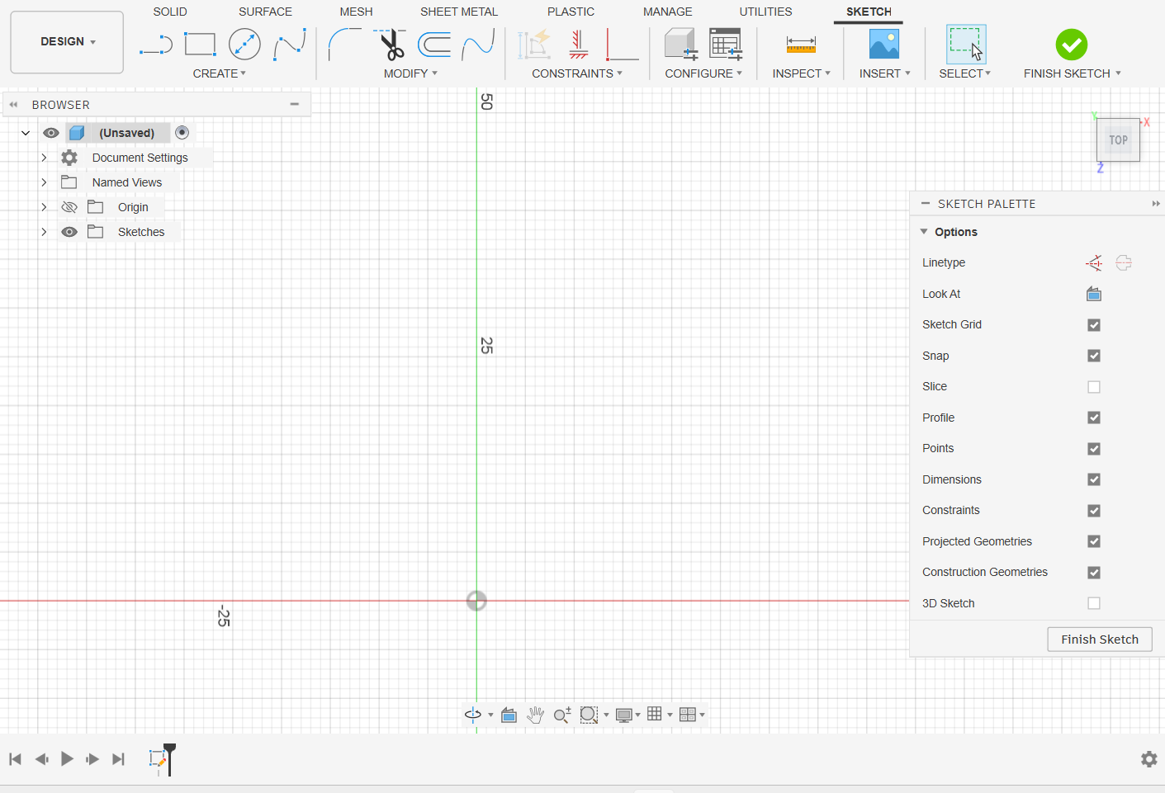
Example
Plane

Slide 22
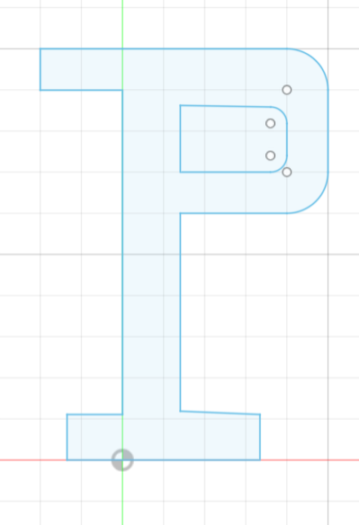
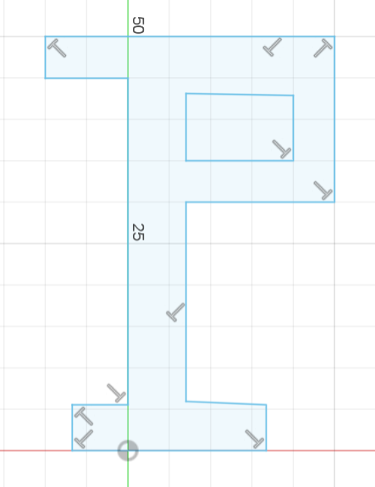
Example
2) Shape

Slide 23
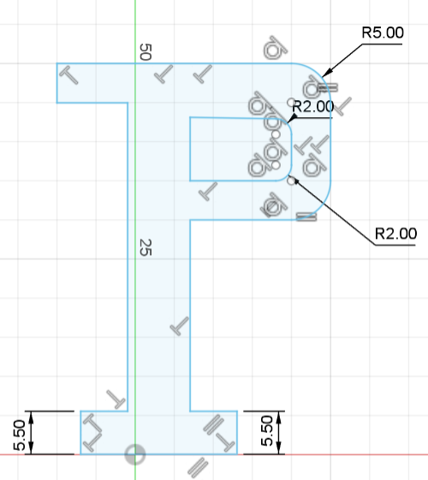
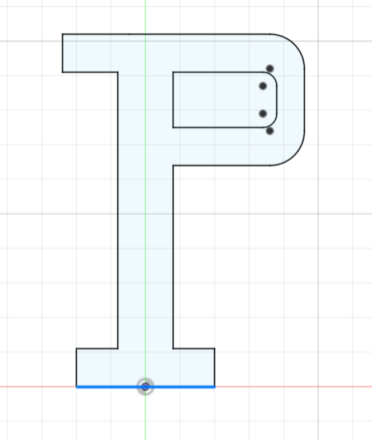
Example
3) Constraints and dimensions

Slide 24
Transforming Sketches

Slide 25
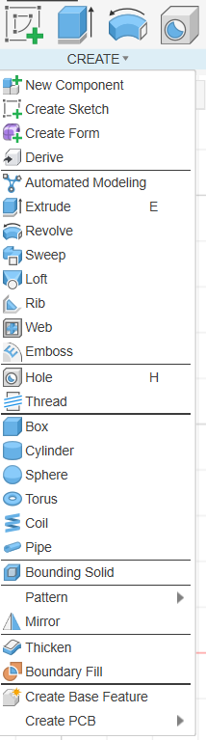
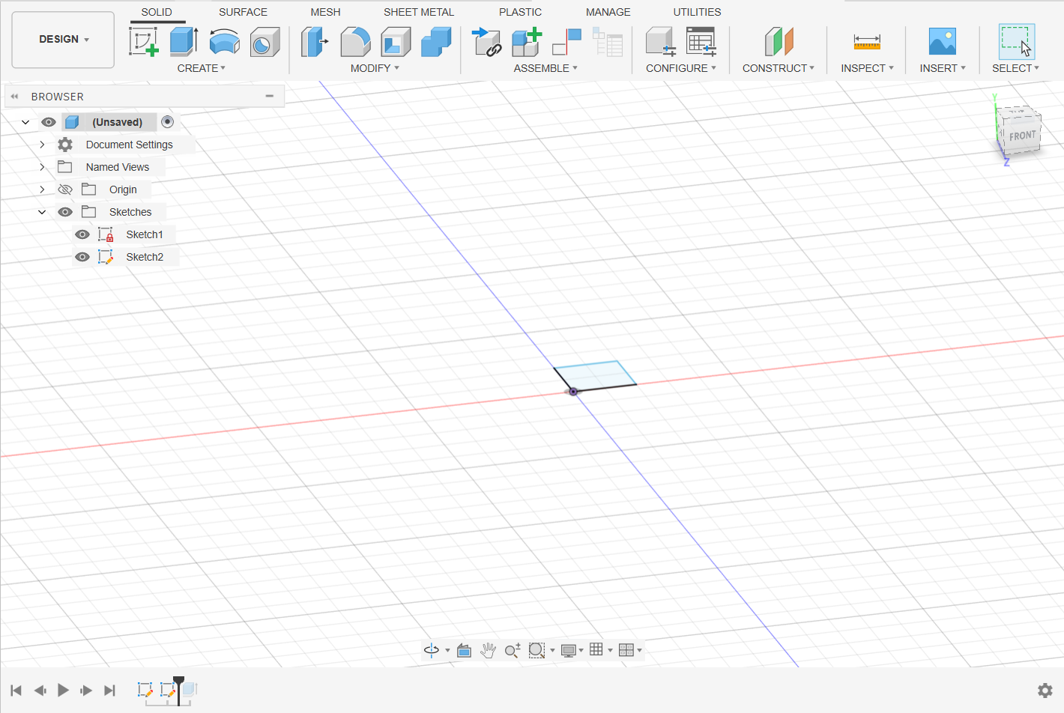
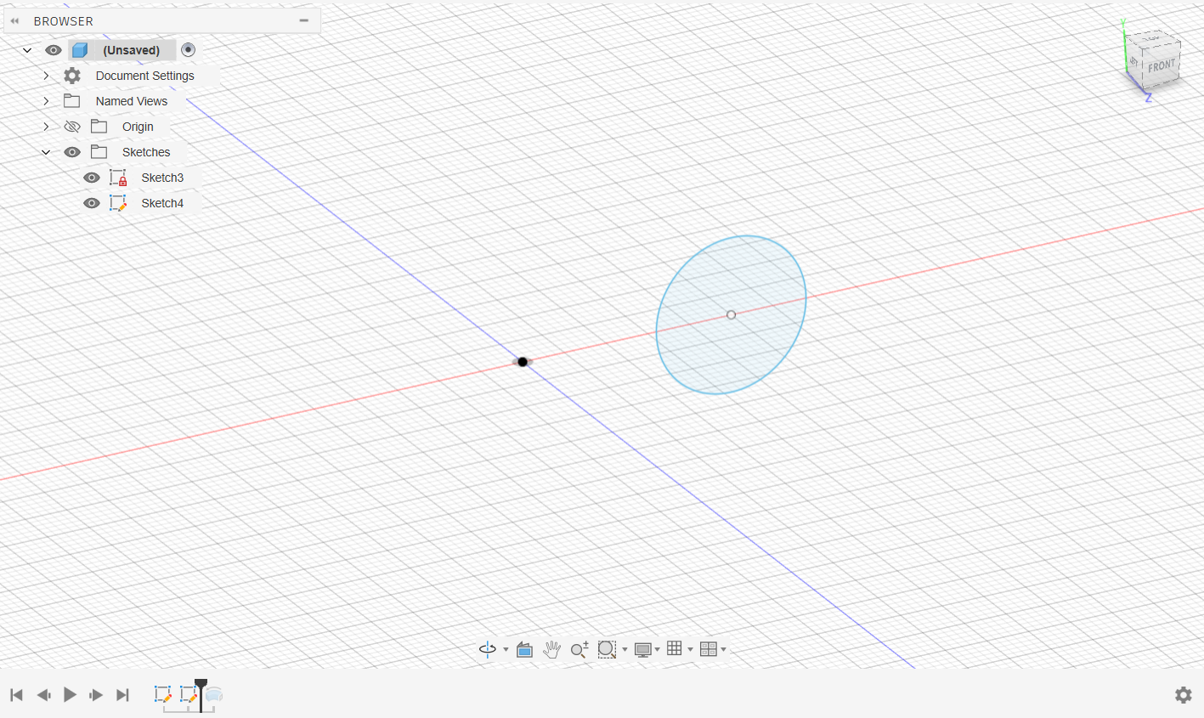
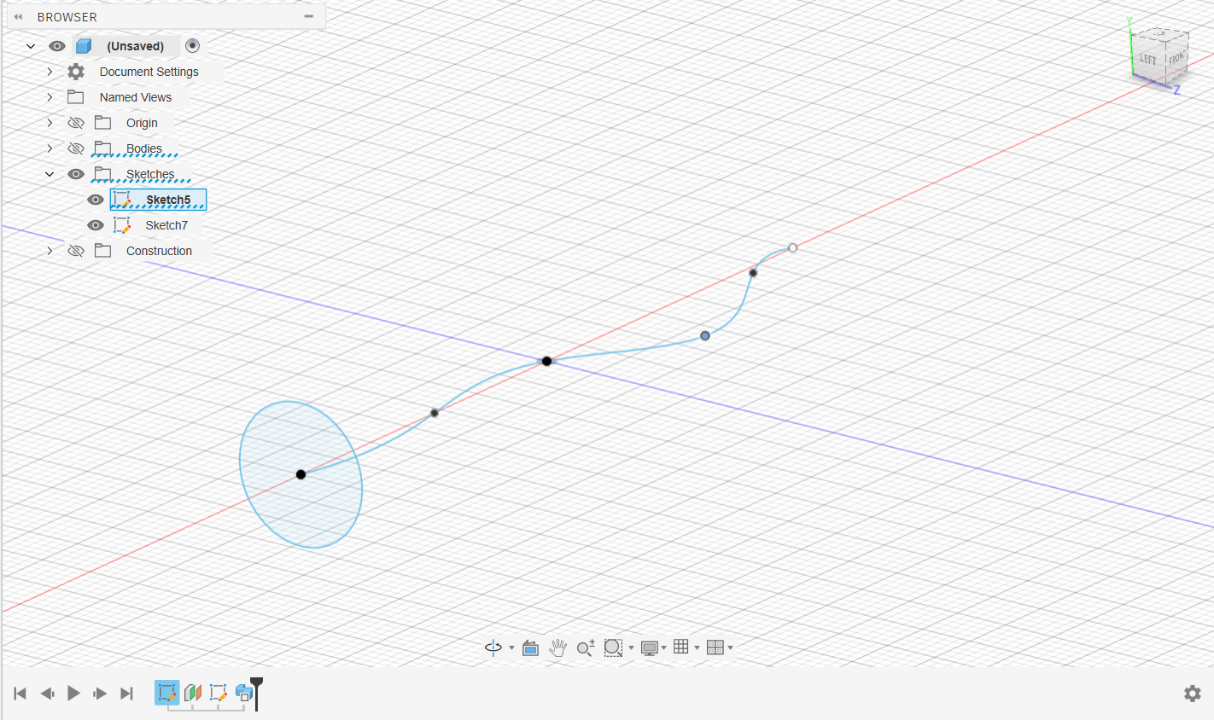
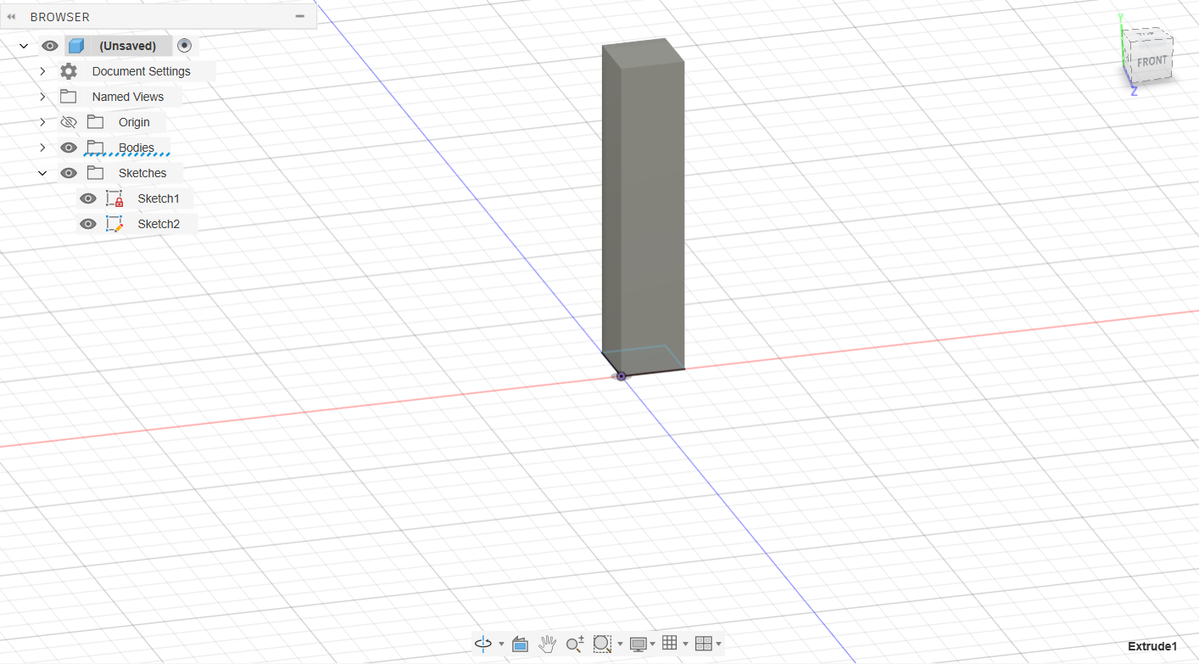
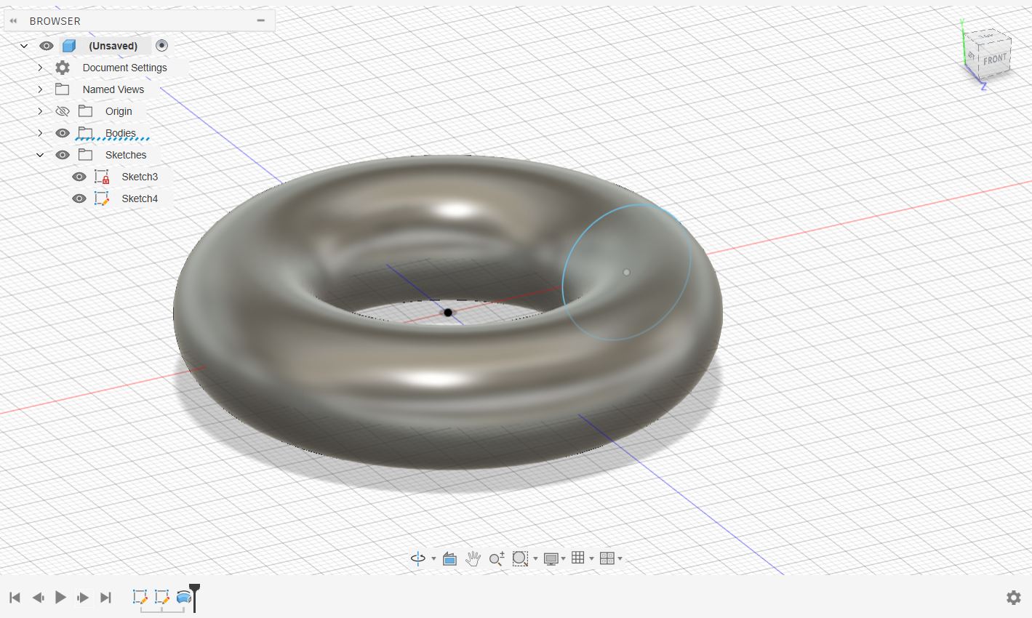
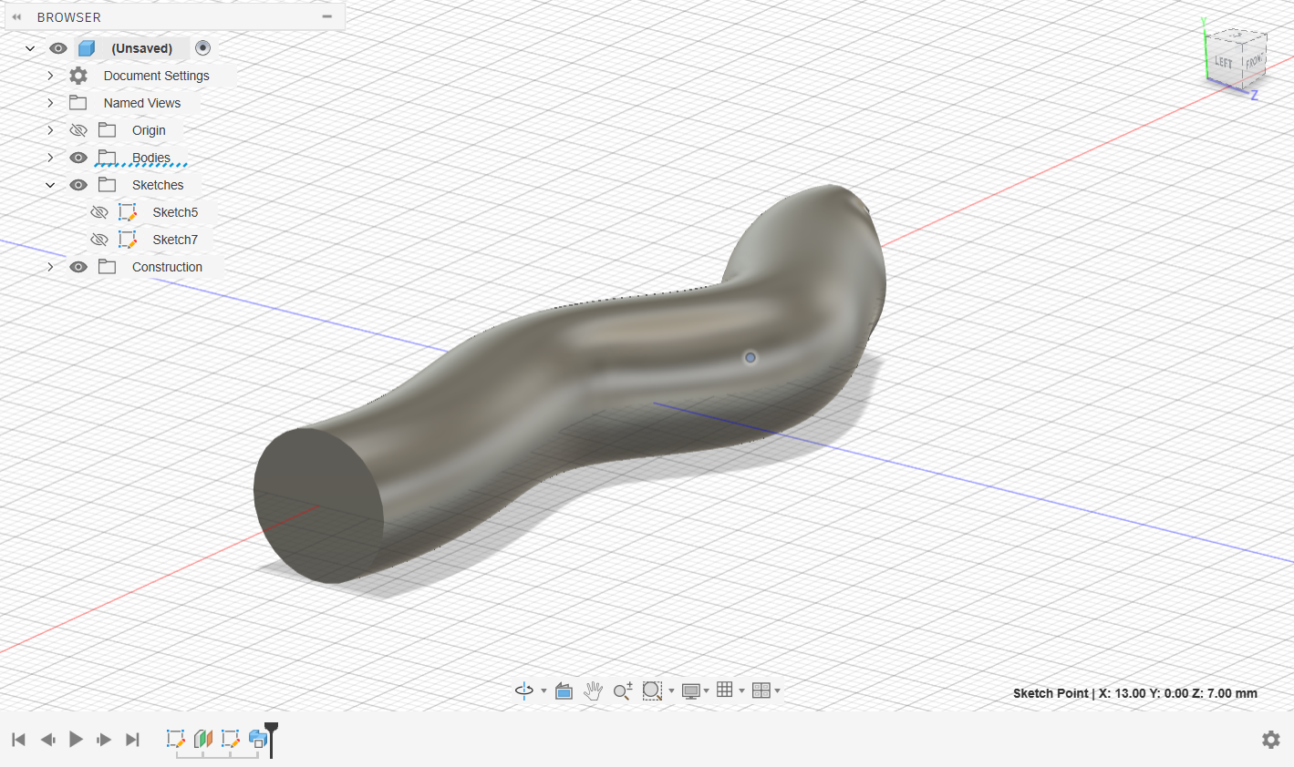
Sketches to 3D Models
Extrude
Revolve
Sweep

Slide 26
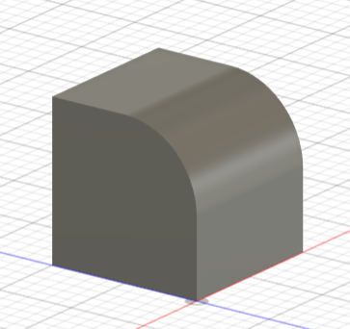
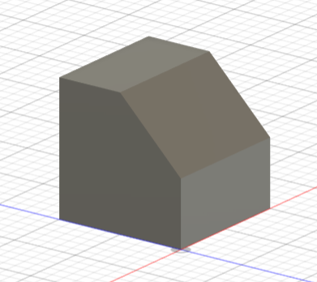
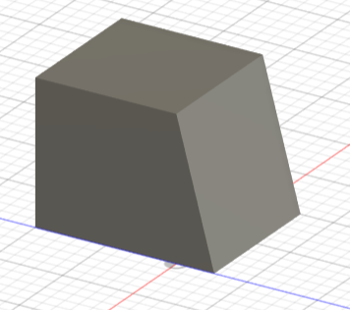
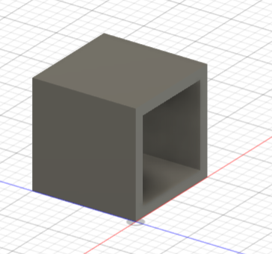
Modifying 3D Shapes
Fillet
Chamfer
Draft
Shell

Slide 27
Example
Create a cylinder with an extrusion
Revolve a square around the Y axis

Slide 28
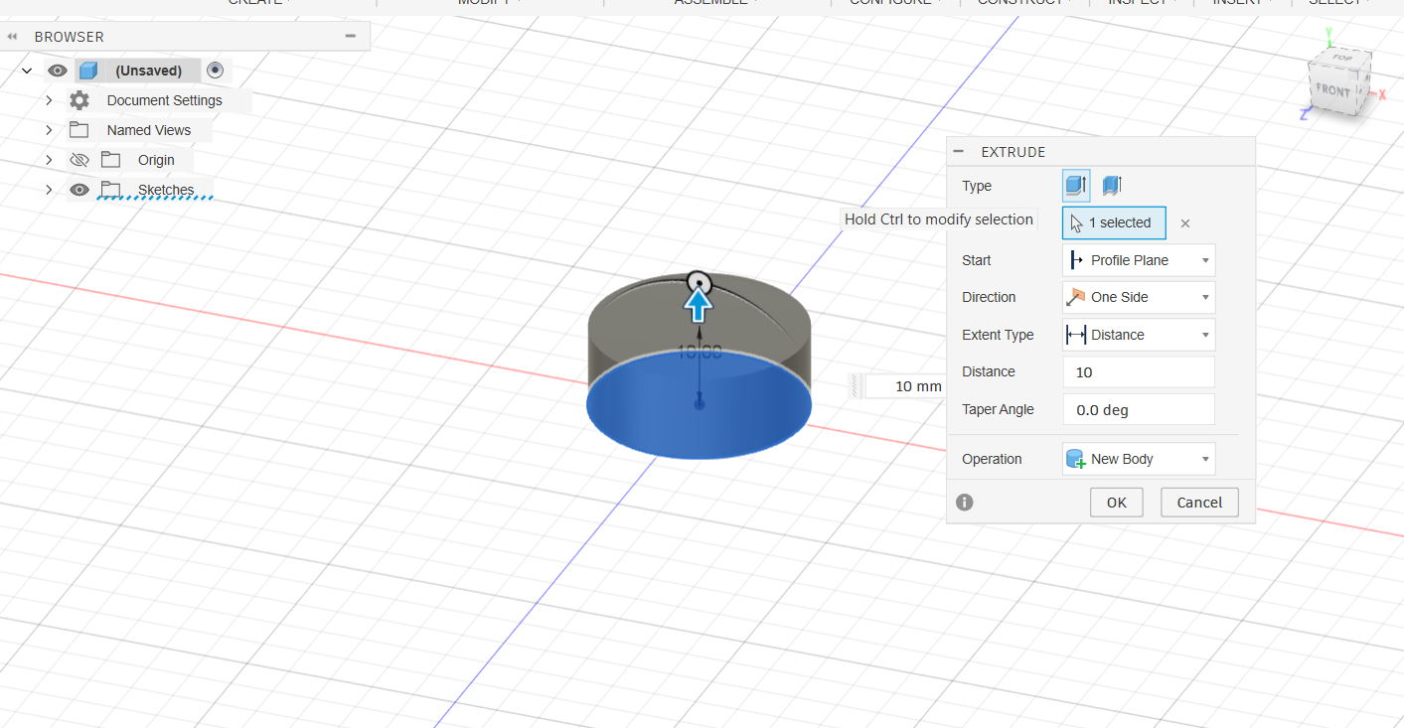
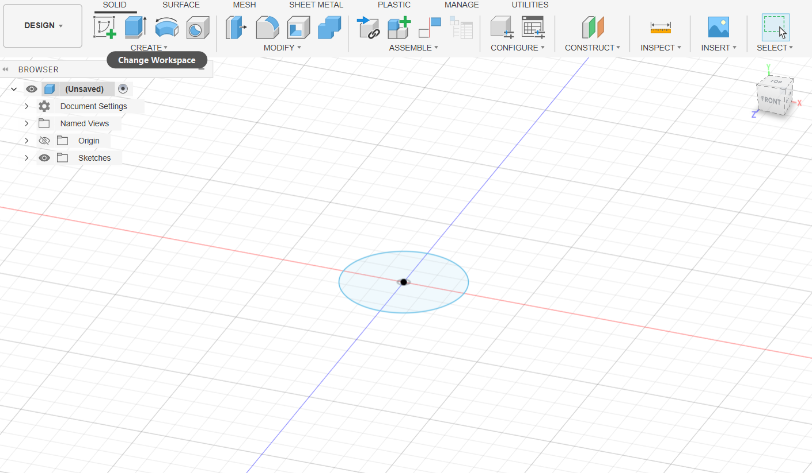
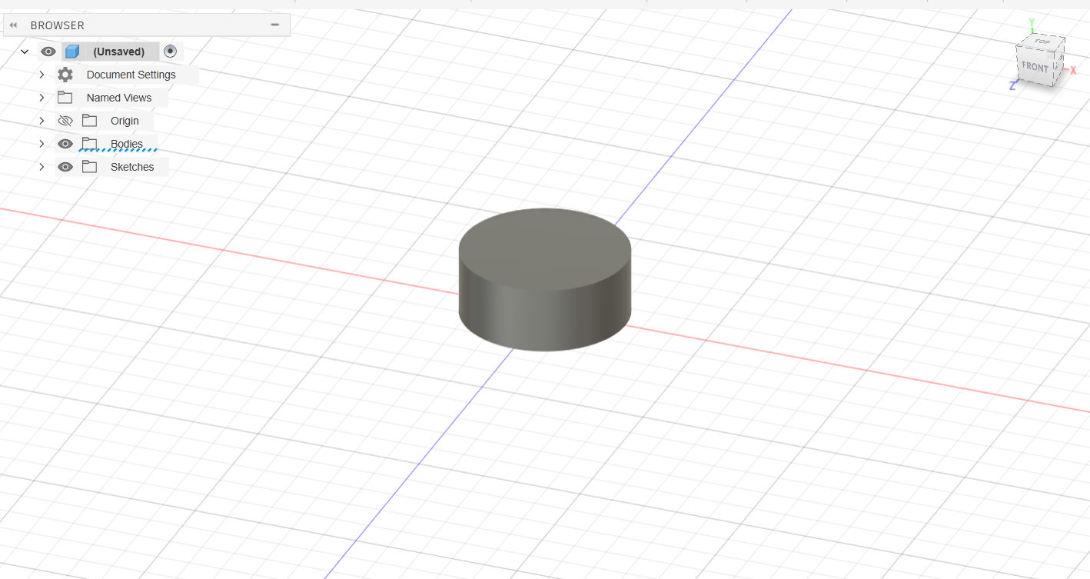
Solution
Cylinder

Slide 29
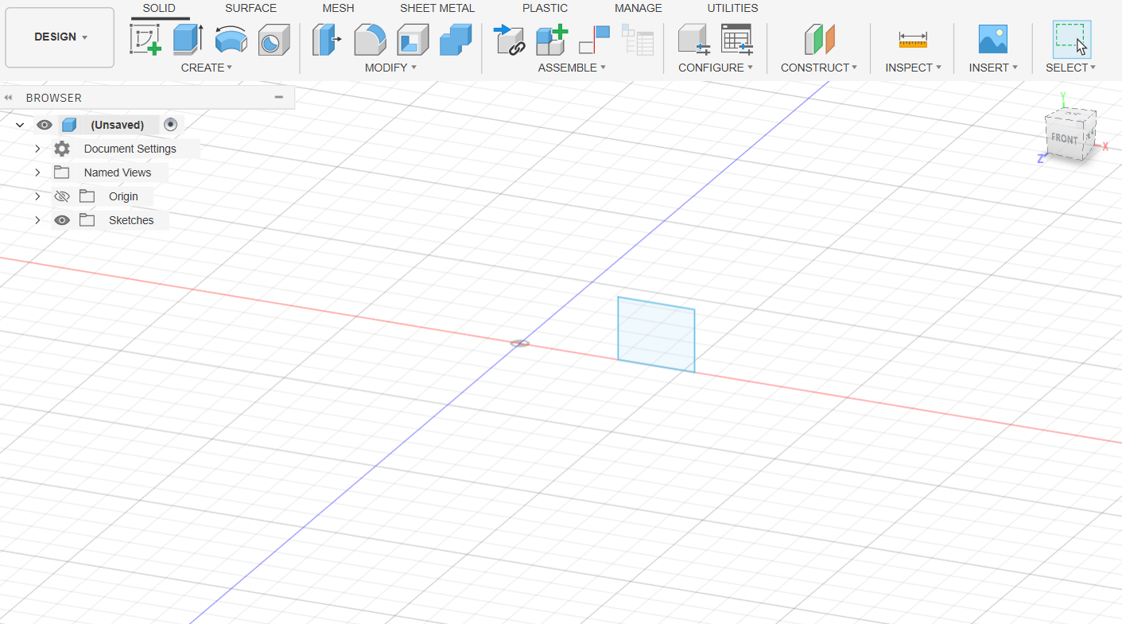
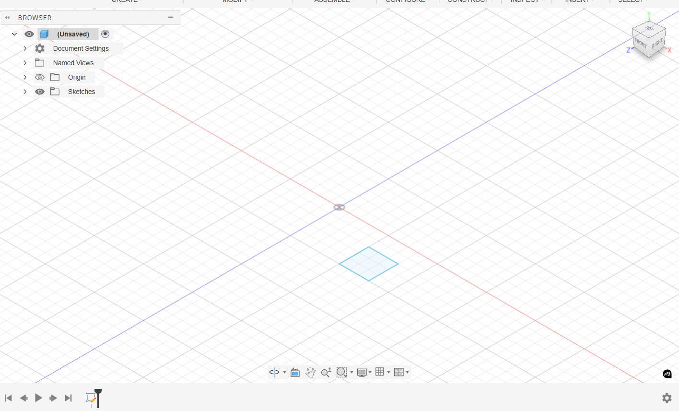
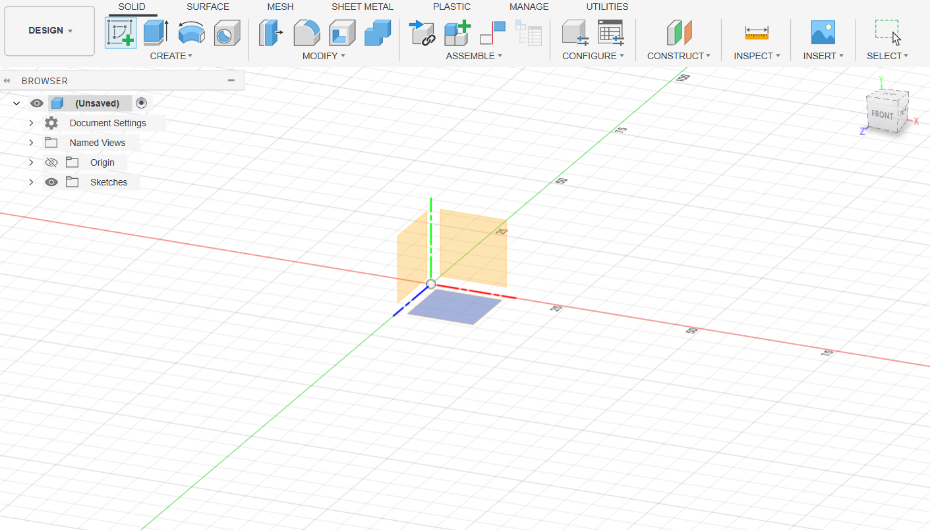
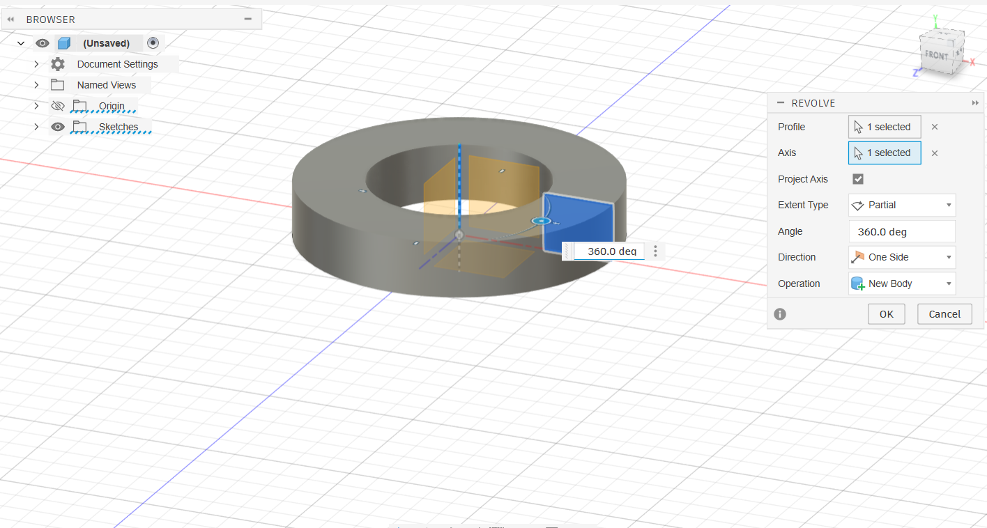
Solution
2) Revolve

Slide 30
Example
Create a cylinder with an extrusion and use the shell feature
Revolve a square around the Y axis and fillet the two outside edges

Slide 31
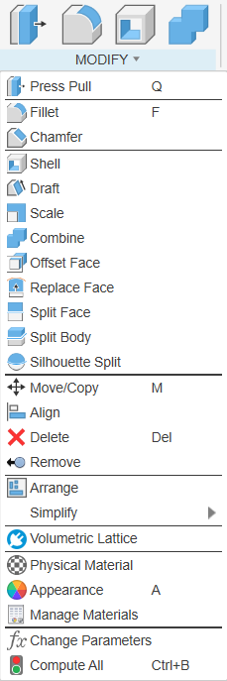
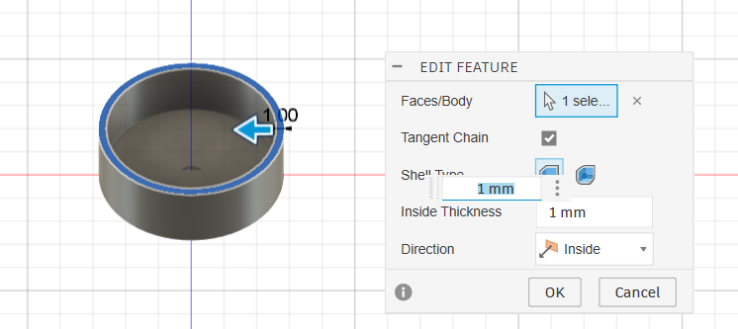
Example
Shell

Slide 32
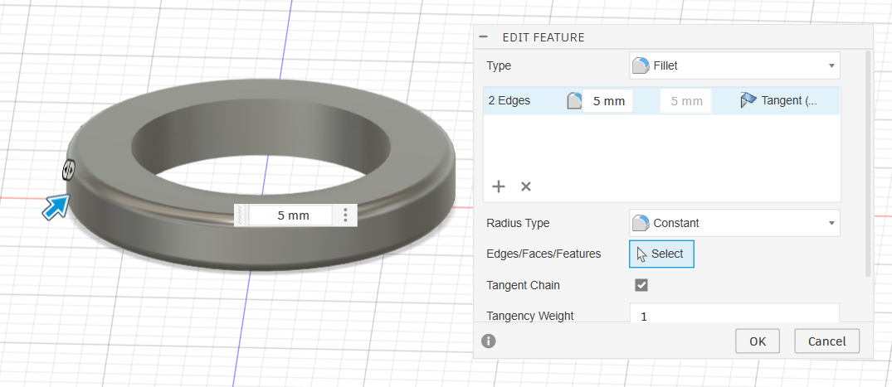
Example
2) Fillet

Slide 33

DEMO!
From your sketch, extrude your Purdue P and then modify it using one the tools.

Slide 34
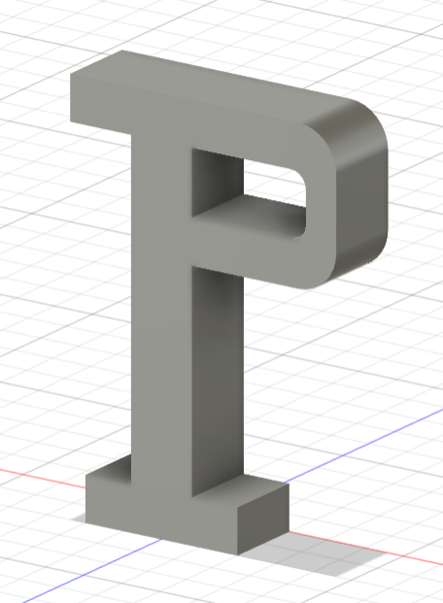

Example
Extrusion

Slide 35


Example
Shell

Slide 36


Example
Chamfer

Slide 37
Thanks!
Question?

