Slide 1
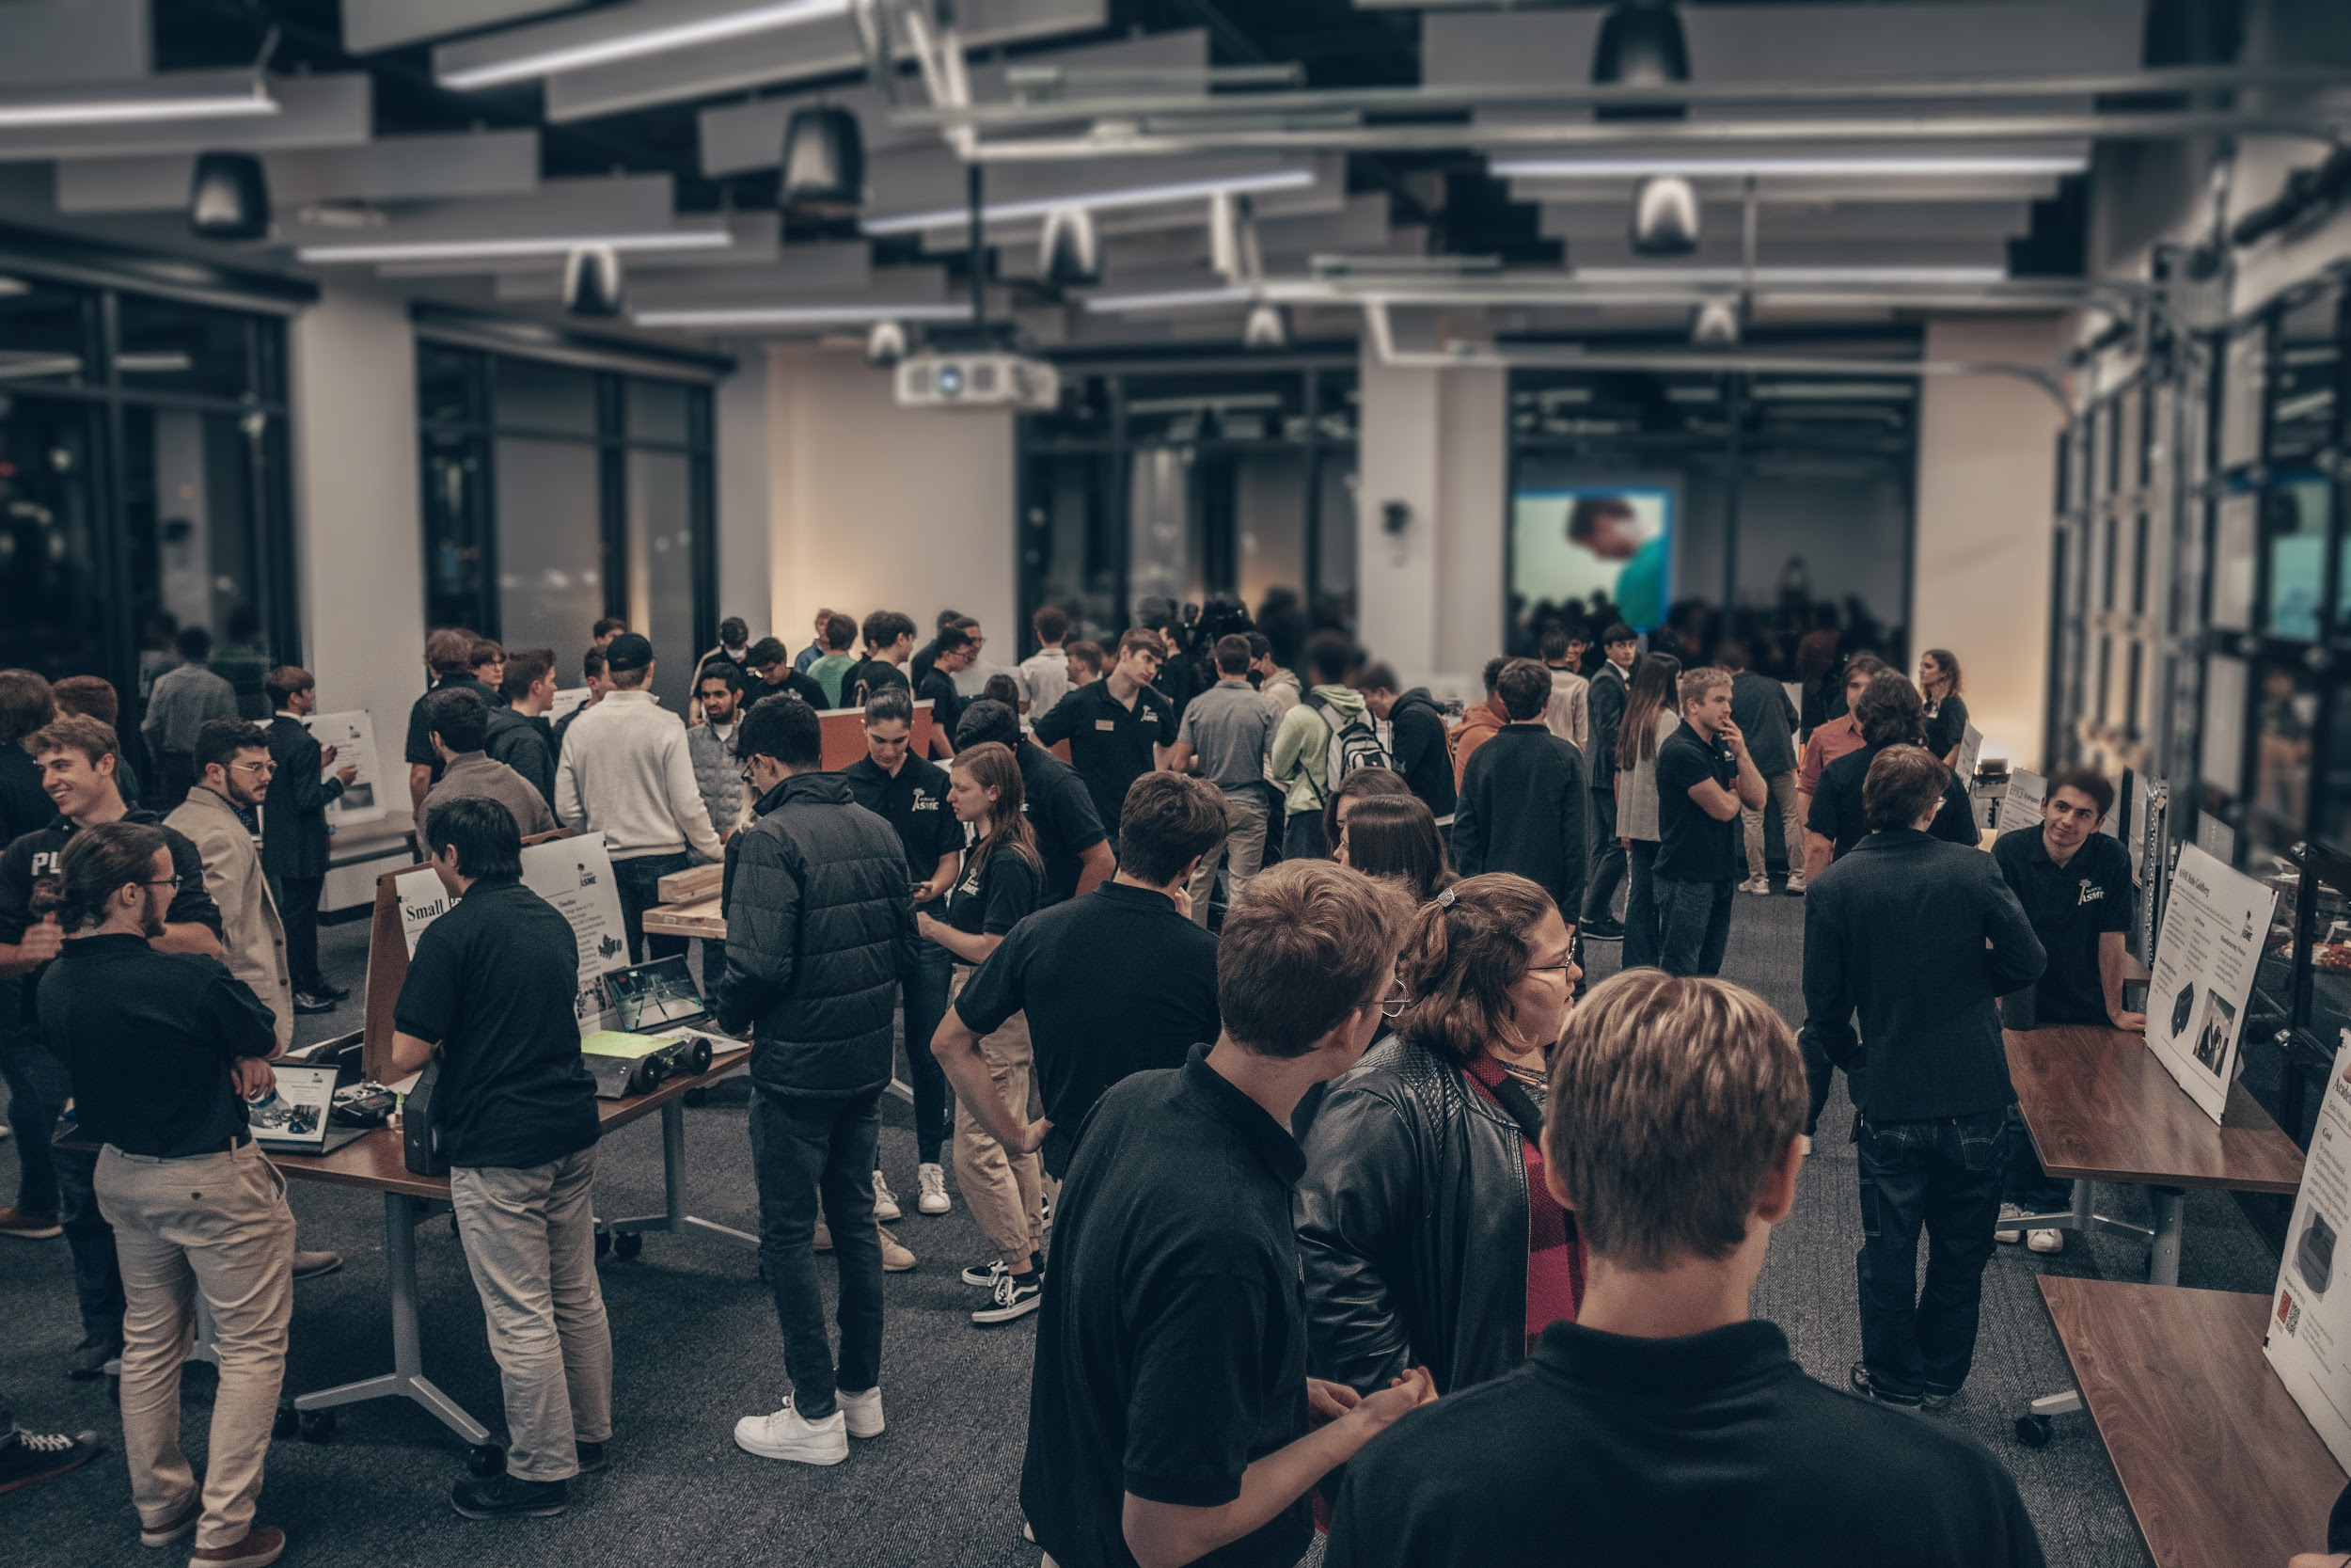


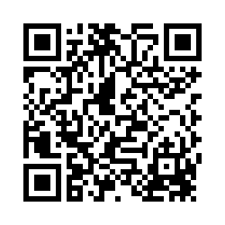
Professional Development Session
IR Prep and Resume Tips
Scan to Sign In
Notes:
Audrey

Slide 2


Please welcome Deloitte!

Slide 3

Agenda
A Note from Deloitte
Introductions
Industrial Roundtable
  Strategy
  Elevator pitch
  Get interview
  Get jobs
International Students
  Research company background
  Communication
IR Q&A
Resume
  Goal of a resume
  Format suggestions
  Building the perfect bullet point
Resume Reviews
.
Notes:
Bryce

Slide 4
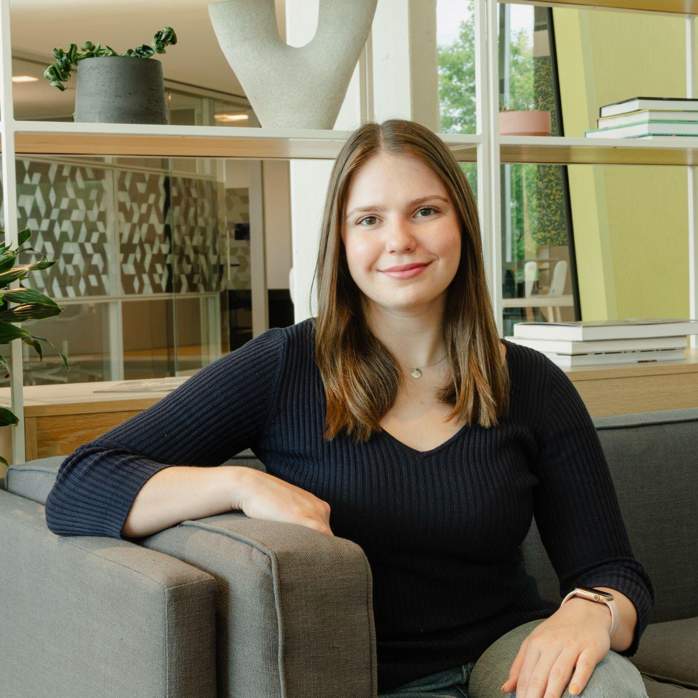
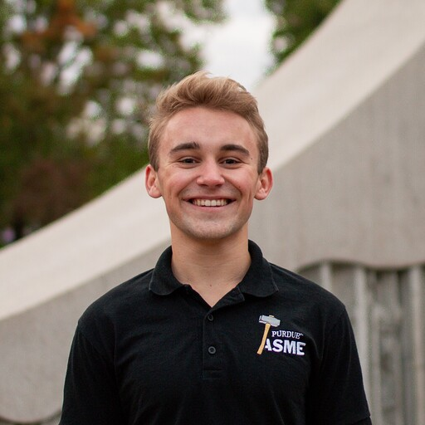
Introductions
Audrey DeKoninck
Master’s Student in ME
Bryce Tucker
Junior in AAE
Notes:
All

Slide 5
Audrey
Bryce
Who Are We?
ASME Board of Directors, former President
Design & Manufacturing Thesis Research Concentration
2x Product Engineering Intern, Steelcase
Mechanical Engineering Intern, Stellantis
2x Quality and Manufacturing Intern, Roush Advanced Composites
ASME External Vice President
Test Stand Lead, PSP-Liquids
New Glenn Manufacturing Engineering Intern, Blue Origin
Engine Control Systems Project Engineering Intern, Collins Aerospace
Notes:
All

Slide 6



Your Brand
Coincides with your image
  Think of companies you recognize easily - everything is cohesive
Resume, Elevator Pitch, LinkedIn, etc. are facets of your brand
How do you want others to perceive you?
What sets you apart from everyone else?
  Culmination of skills, experiences, and personality
What do you offer?
What are your goals and interest?
Notes:
Audrey

Slide 7
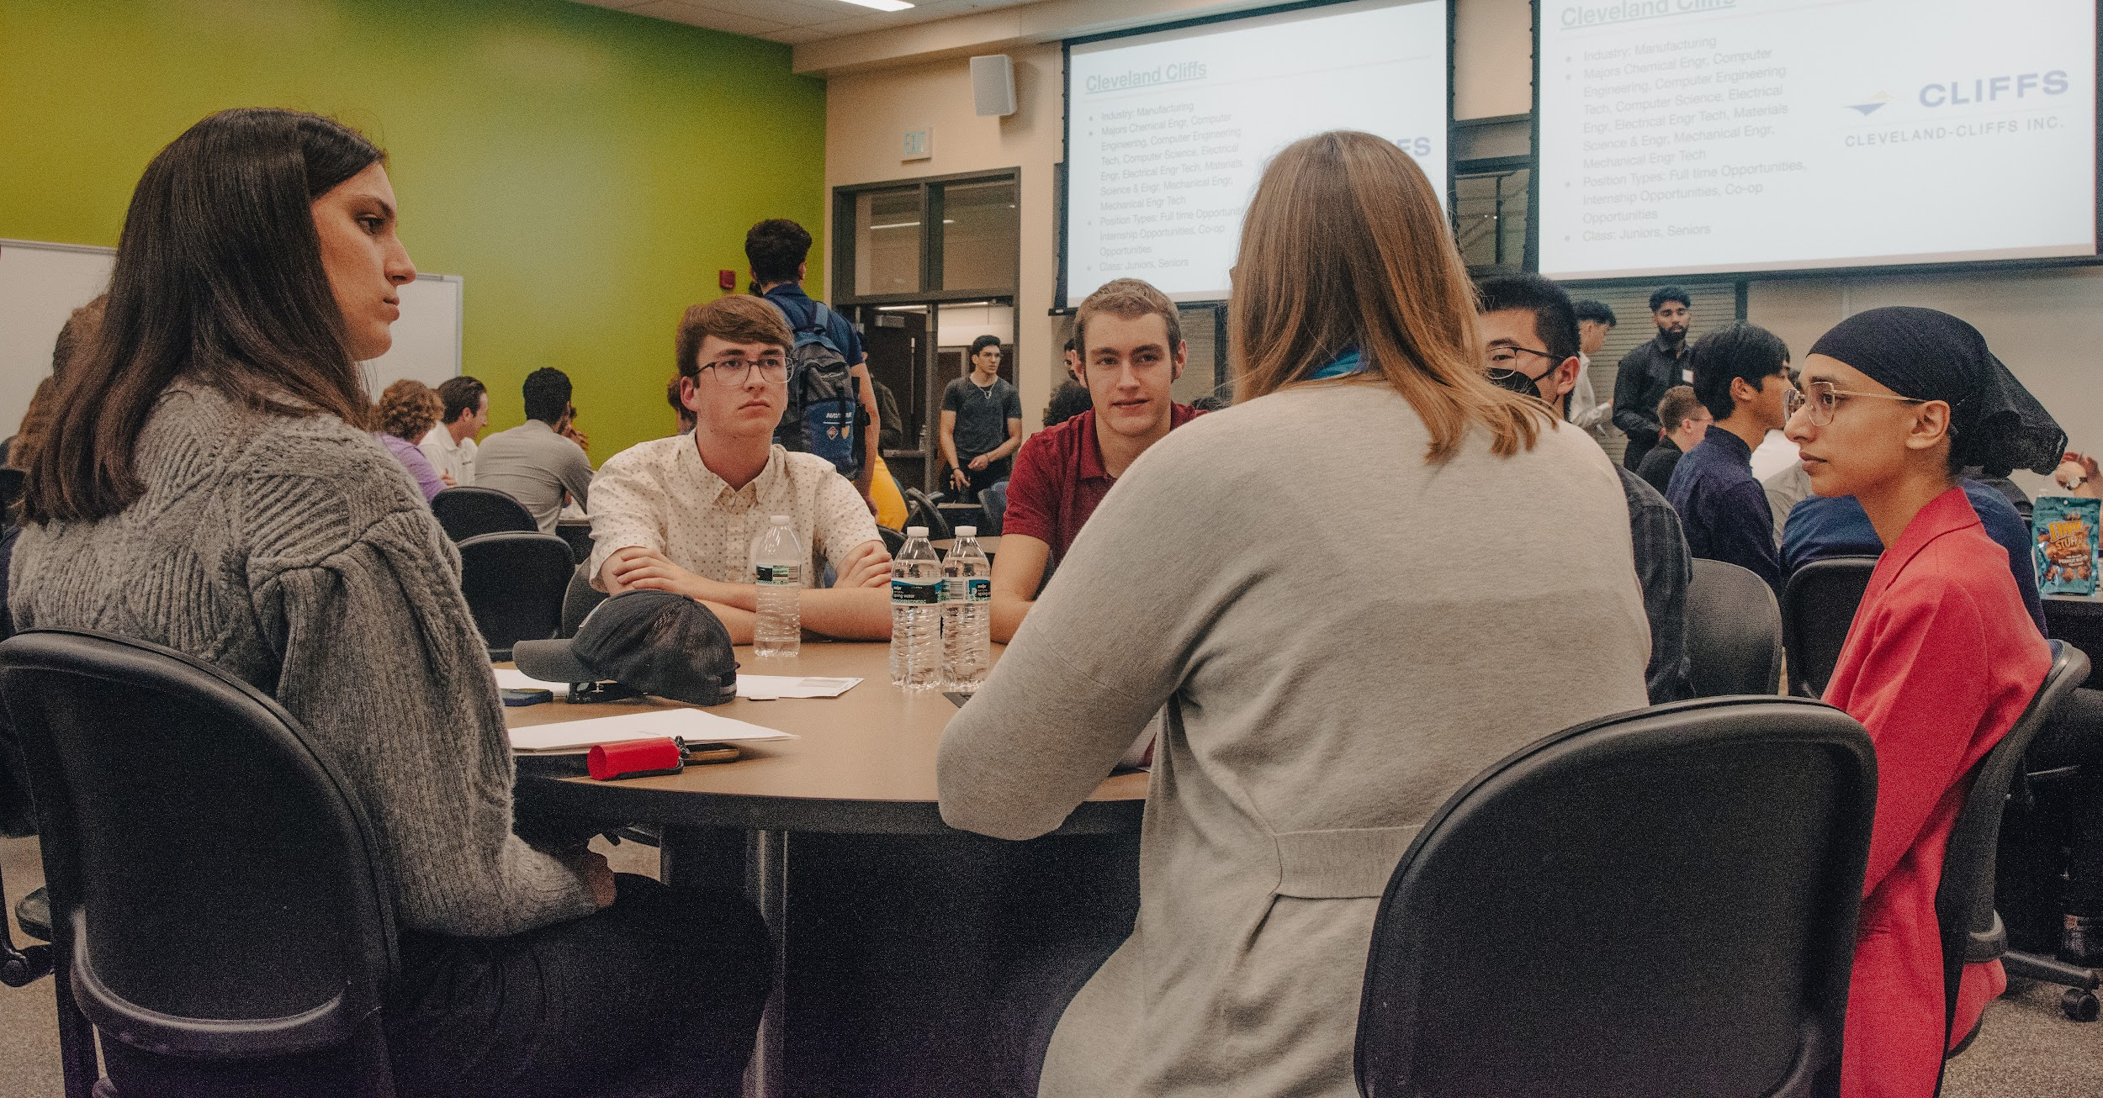
Industrial Roundtable
Notes:
Bryce

Slide 8
IR: The Goal
Highlight what you’re interested in and how your past experience aligns with that
Showcase communication skills
Indicate why you are there
  Internship/job, specific area, etc.
Engage with who you’re talking to
  Ask about what they do/teams at their company
You don’t need to stick to a script
.
Notes:
Bryce

Slide 9

Elevator Pitch
“Hello, how are you?”
  Introduce yourself and get their name
Highlight what you're looking for
Keep it short
Ask about specific opportunities
Practice & experiment
If a conversation starts out of your pitch, roll with it
  Don’t just talk at them
  Don’t just throw information at them
.
Notes:
Bryce

Slide 10

Preparation
Know your resume
Practice your elevator pitch
Choose target companies
  Map them out - Career Fair Plus
  Apply online ahead of time
  Plan questions
If you are going to talk to a company have a general idea of what they do
Network at prior events
  ASME corporate banquet, company seminars - go talk to them after the event
Get there early
Notes:
Audrey

Slide 11
Game Day Checklist
Print a bunch of resumes (30ish?)
  Have a digital version on your phone ready to upload with a clear file name
Have a folder to put everything in
Notepad - write down names and jobs
Dress nice. It definitely matters
  Men: Ex. jacket with no tie
  Women: Ex. nice blouse or suit
Some beverage (preferably water)
Name tags are great too
Notes:
Audrey

Slide 12


Be the Question Master
Do ask questions…
  throughout the entire conversation
  about the person you’re talking to
  you want to know the answer to
  that are unique and thoughtful
  about specific roles/positions
Don’t ask questions…
  that can be Googled
  that are generic
  about pay
Notes:
Audrey

Slide 13

The Finisher
Ask about current open positions
  What are they hiring for at IR?
  Use this to show interest in a specific role
If you've already applied ask about next steps
Ask how to continue the conversation
“Thank you, ______”
Connect on LinkedIn
.
Notes:
Bryce

Slide 14
International Students
Navigating Job Applications and Recruitment
Notes:
Tips for International Students: Navigating Job Applications and Recruitment
Research Company Background
Focus on companies that hire international students.
Use reliable resources like Reddit, MyOPTJobs, or forums tailored for international applicants.
Check job applications for notes about hiring non-US citizens. Only ~20% of companies explicitly mention this.
Target Your Applications
For big companies like GM or Subaru, if they clearly state they don’t hire non-US citizens, it’s better not to apply to avoid wasting time.
If no information is available, still consider applying—you might discover opportunities.
International Student Status
Mention your status as an international student upfront when speaking to recruiters.
This helps recruiters clarify whether they can hire you, saving both time and effort.
In-Person Recruitment (e.g., Career Fairs)
Always double-check company policies even if they state eligibility on the application—some recruiters may give conflicting or updated information.
Be prepared for mixed responses, and focus on companies genuinely open to international hires.
By following these steps, you can streamline your job search, target companies effectively, and save time while managing your expectations.

Slide 15


Research Company Background
Target companies that hire international students.
Use resources like Reddit or MyOPTJobs.
Only ~20% of companies mention hiring non-US citizens explicitly on job applications.
Skip applying to companies that state they don’t hire non-US citizens.
  If unclear, still apply—you might find hidden opportunities.
Notes:
Audrey

Slide 16


Communication
Tell recruiters you’re an international student immediately.
  Saves time and helps clarify eligibility upfront.
Double-check hiring policies in-person even if listed.
  Some recruiters might have updated or conflicting info.
.
Notes:
Bryce

Slide 17
Final Strategies
Prepare, prepare, prepare
Cast a wide net
Channel your inner early bird
Don’t be afraid to sell yourself
Bad interviews happen
Be excited! You’ll do great!
Notes:
Audrey

Slide 18
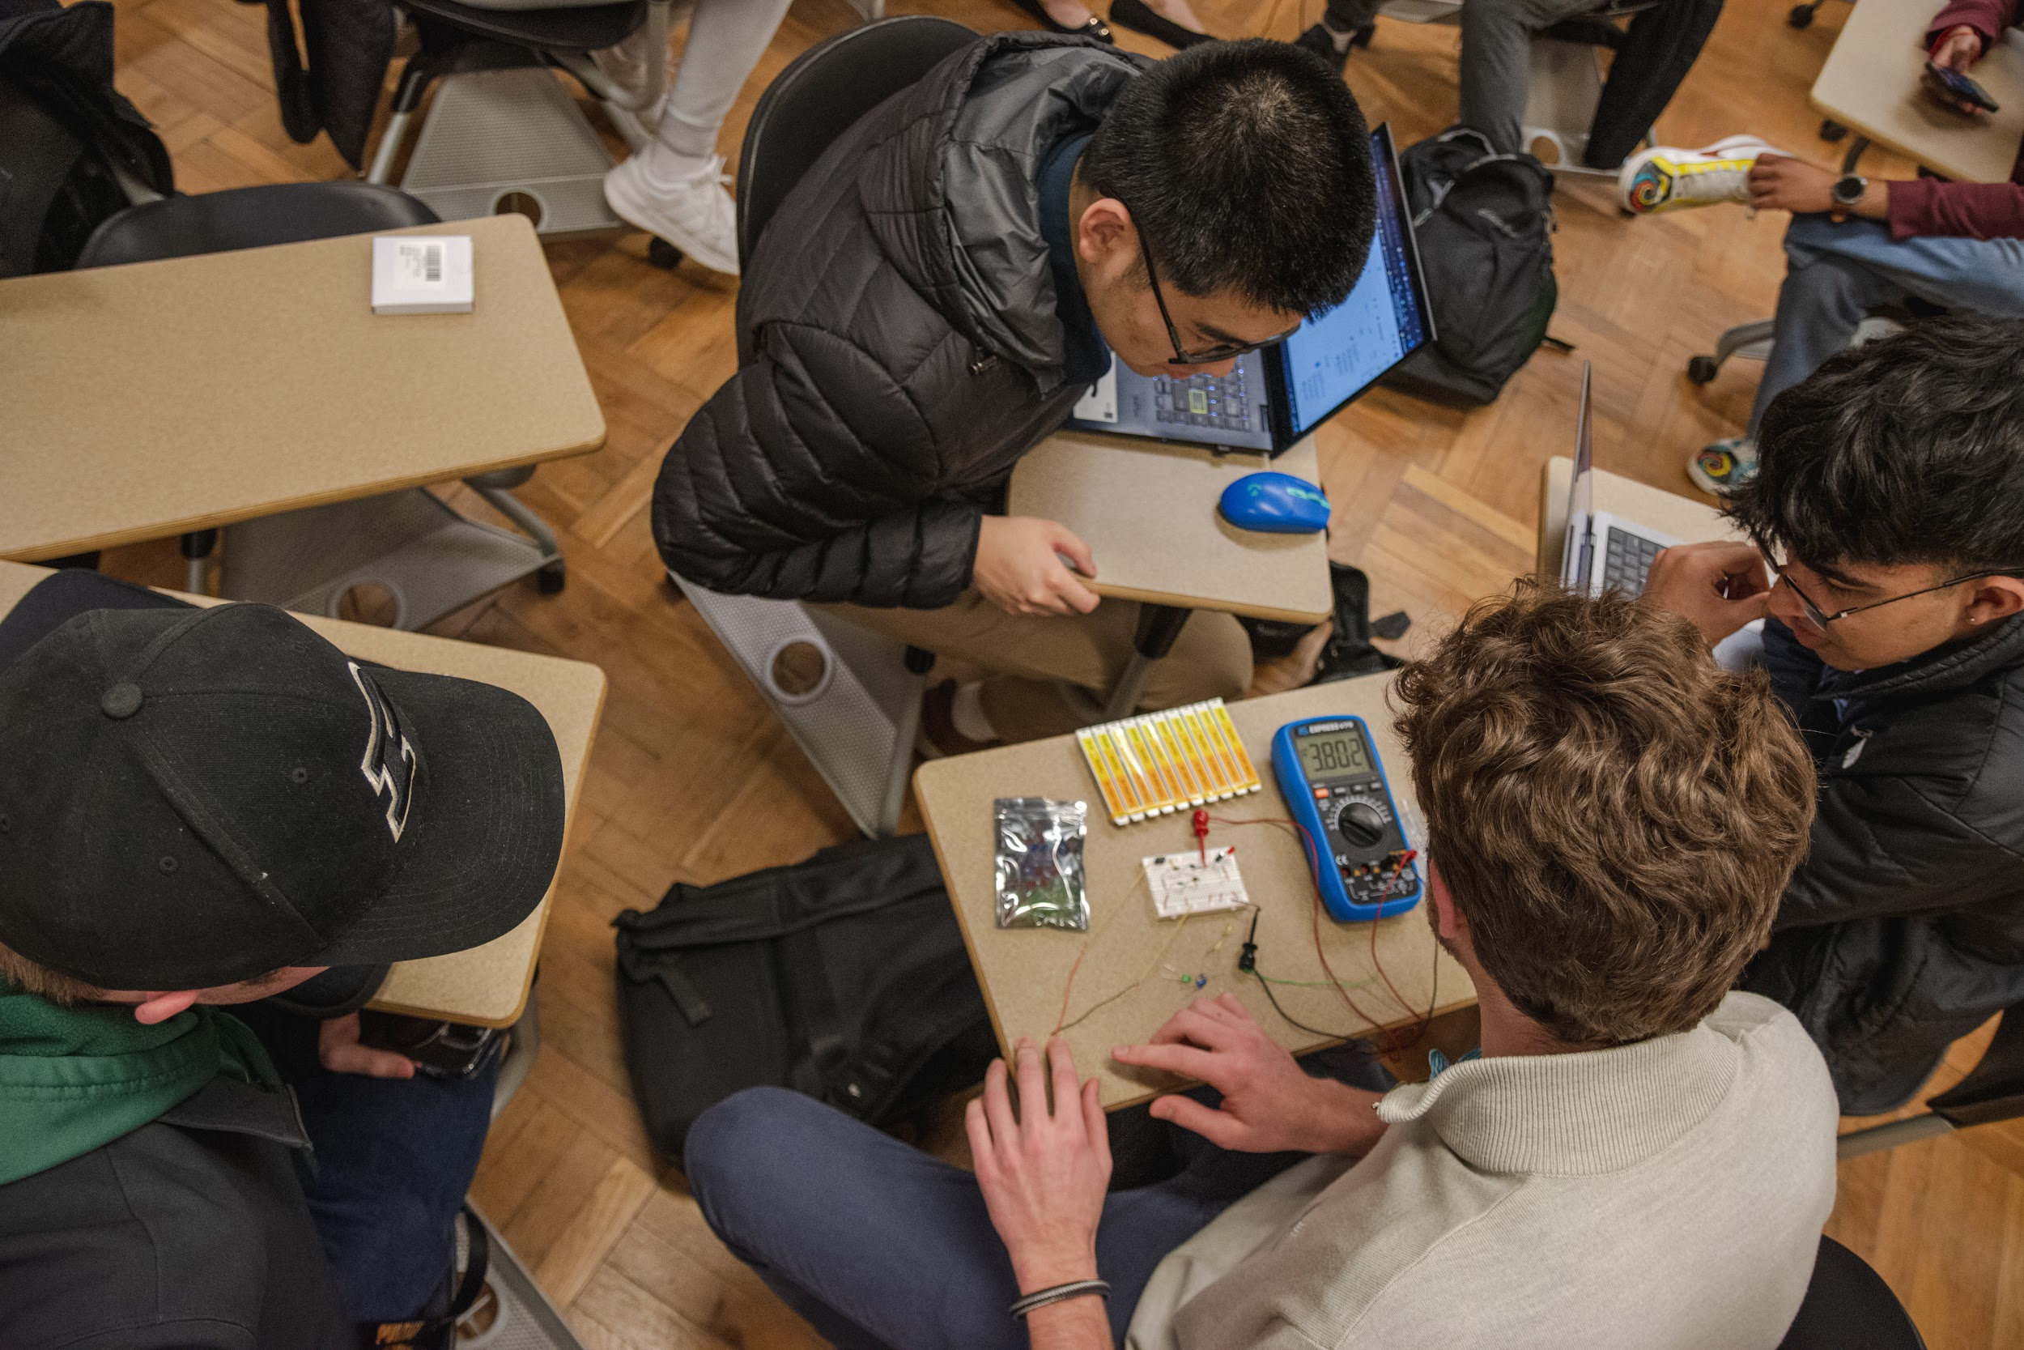
Crafting a Good Resume
Notes:
Audrey

Slide 19
Resumes: The Goal
Tell them who you are on one page
  What sets you apart?
  Paint a picture of how you think
Introduce your skills and qualifications to an employer
  What can you offer to the company?
  Provide details on your accomplishments
Demonstrate your impact
Notes:
Audrey

Slide 20
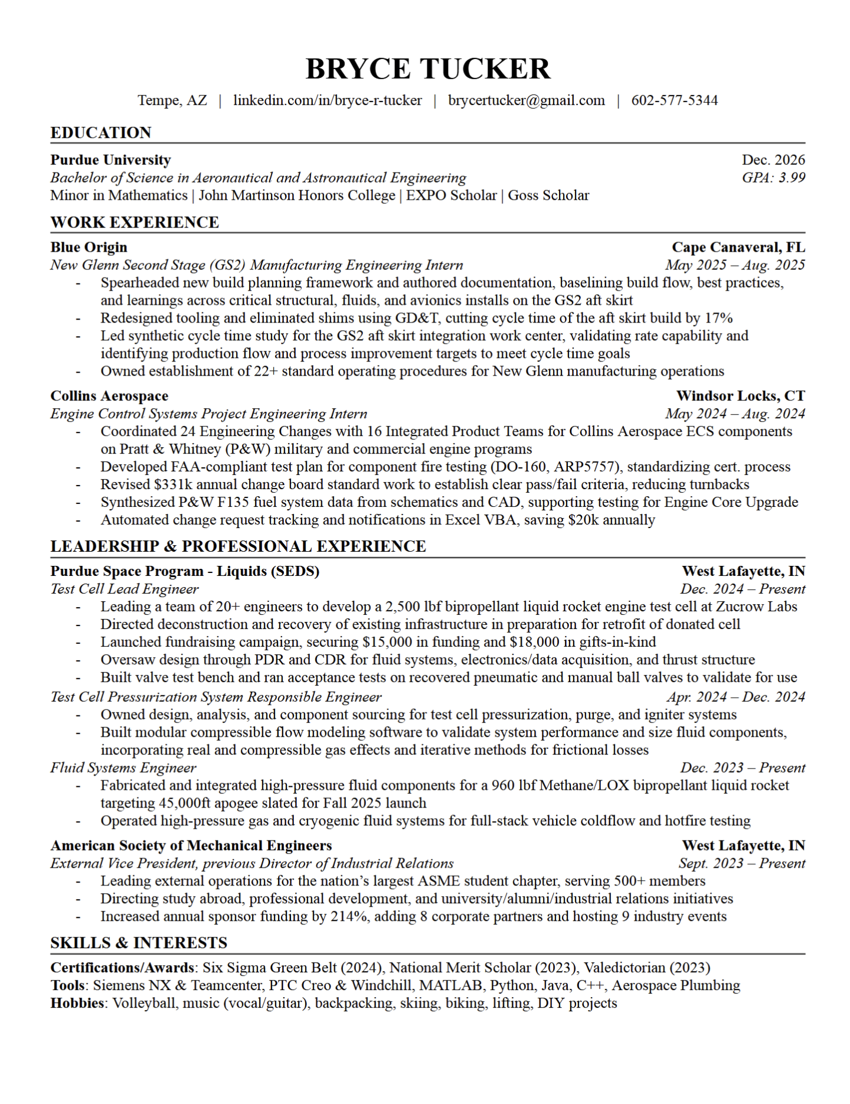
Sections
Header: Name, phone number, email, LinkedIn link
Education: Degree (major/minor), GPA, Graduation date
Relevant Experience: Work history, team projects, description of activity with location
Order of list items should be based on relevance/
chronological
Activities and Research: Extracurricular activities, school/technical involvements, description of activity with location
Skills: Relevant, mentioned elsewhere & summarized here
Include if important or to fill space
Awards/Certs: Awards, honors, short description with year
.
Notes:
Bryce

Slide 21
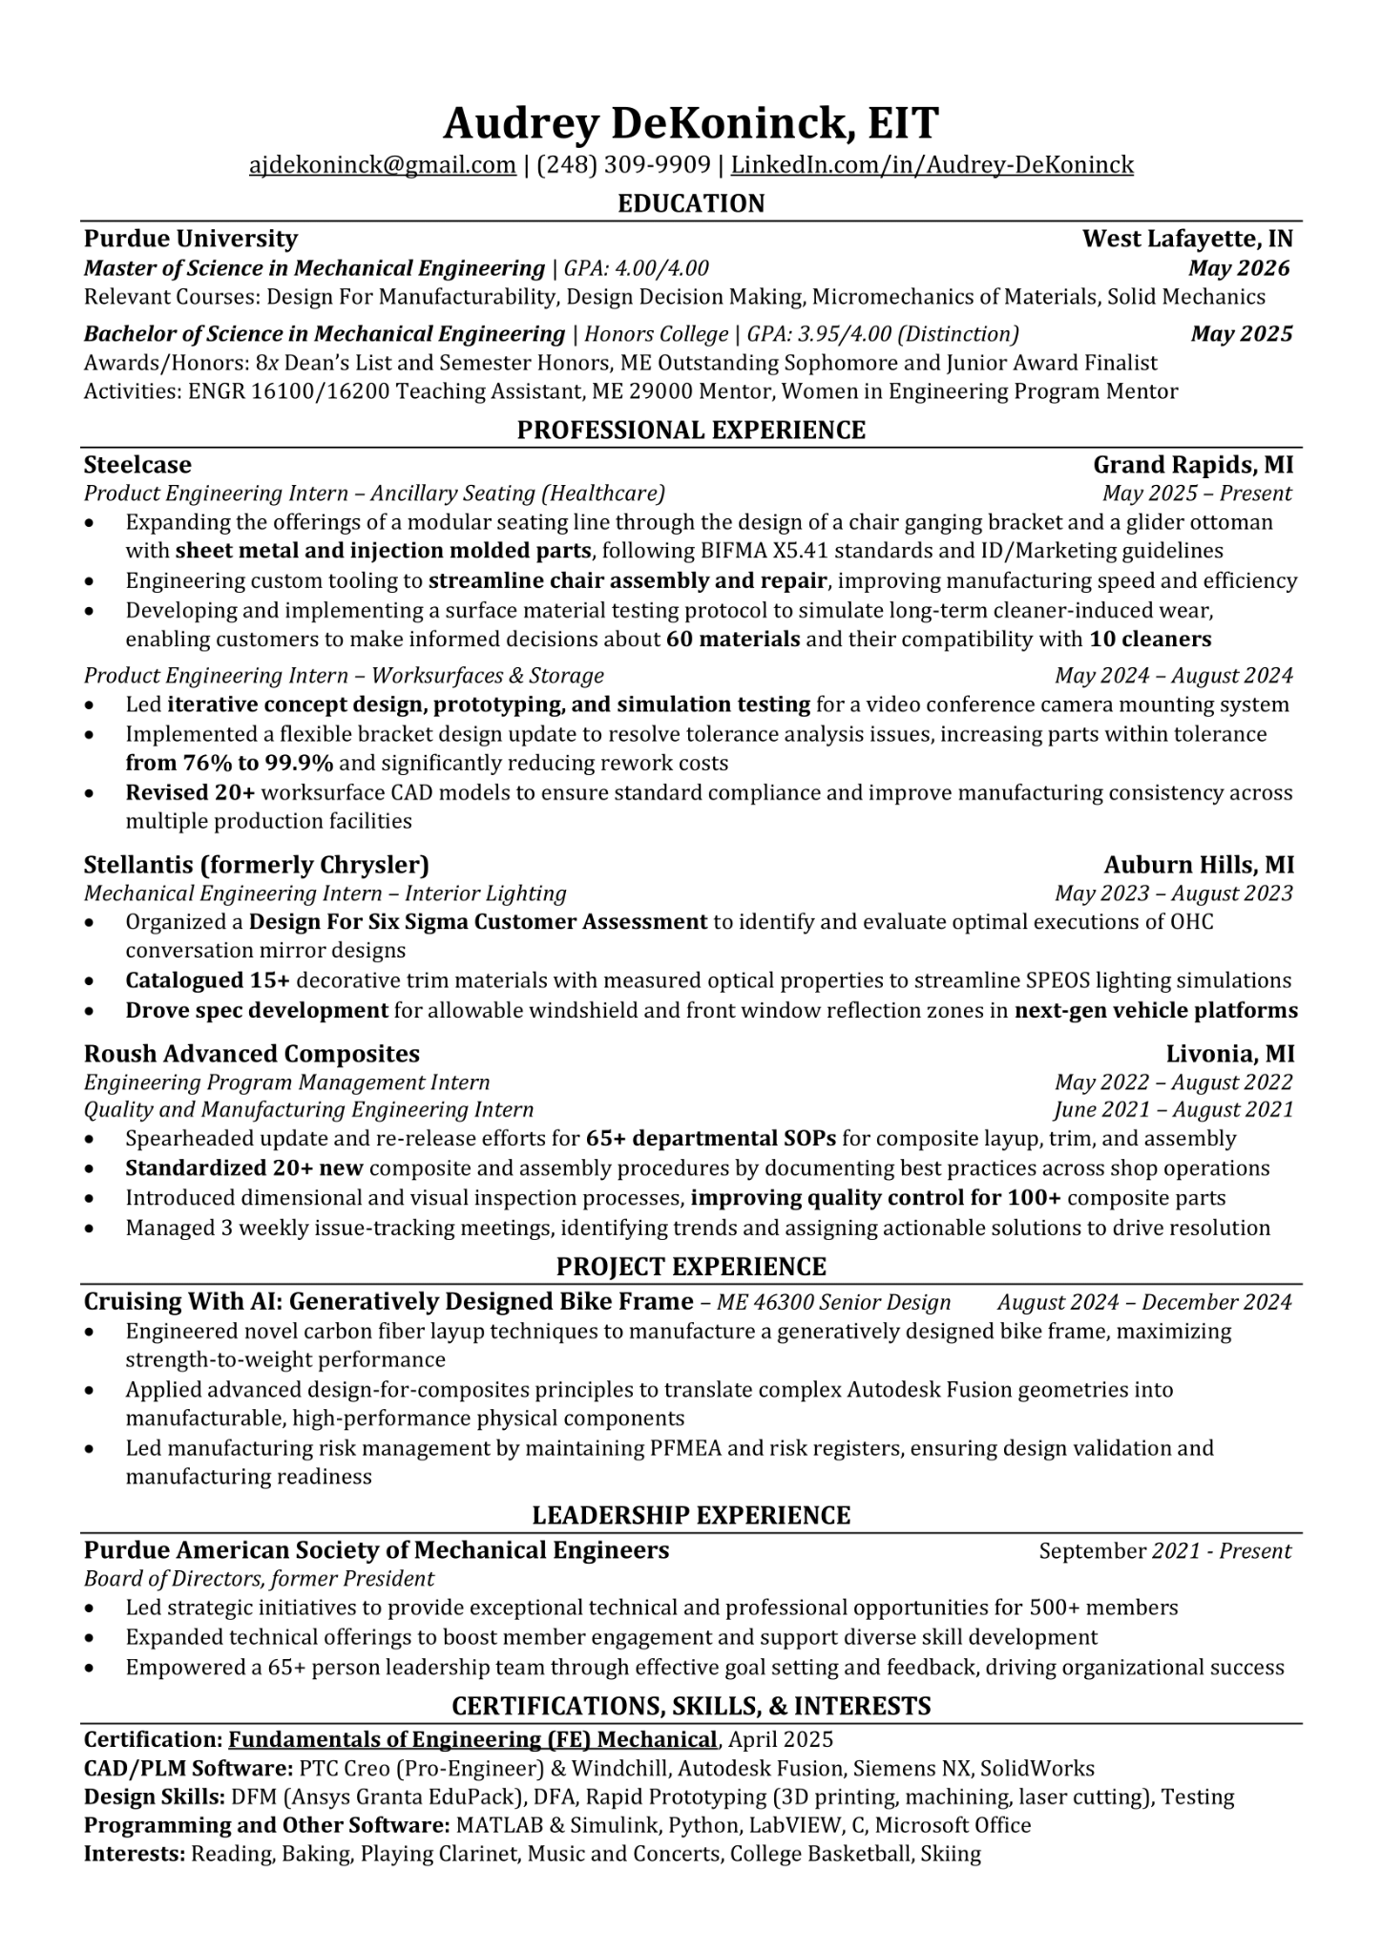
Formatting
One page only!
Font
Common and easy to read
Same on entire page
Font size no smaller than ~11
Keep it consistent
Avoid Cluttering
Modest Margins
Good Spacing
Ensure Readability
Notes:
Audrey

Slide 22
Crafting The Perfect Bullet Point
I worked on a team that made parts for planes
Refrain from using personal pronouns.
Worked on a team that made parts for planes
What did you do?
What type of parts? What planes?
Designed structural components for landing gear of Gulfstream G650
Quantify. Elaborate.
To do… what?
Designed and analyzed 20 structural components using Solidworks for landing gear of Gulfstream G650, reducing weight of current components by 50%
Too long. Simplify!
Reduced weight of Gulfstream G650 landing gear by 50% through design and analysis of 20 components in Solidworks
Begin with results
.
Notes:
Bryce

Slide 23
Do’s and Don’ts
Do:
Organize your resume based on relevance/chronological order
Consider different resumes for different disciplines
Optimize according to ATS
Ensure readability
Check for grammar
Firstname Lastname Resume 20XX
Don’t:
Use a MS Word template. Ever!!!!!
Include color (unless a recruiter or contact mentions it)
Include high school information if possible
Repeat action verbs
Have an image of yourself
Use passive voice or first person
Have more than 1 page
Notes:
Audrey

Slide 24

Resume Review Opportunities
Get as many eyes on your resume as possible!
ASME Corporate Banquet on 9/8 (ARMS Atrium, 6:30-8:30pm)
  Resume reviews from 6:00-7:00 pm in ARMS 1103
MyCCO
Purdue ME Company Days
ASME Office Hours
.
Notes:
Bryce

Slide 25
Thank you!
Stick around to get your resume reviewed!
Audrey DeKoninck: ajdekoni@purdue.edu
Bryce Tucker: tucke193@purdue.edu
Scan to Sign In

